Slide 1

Kigali Pilot Shop Report

Slide 2
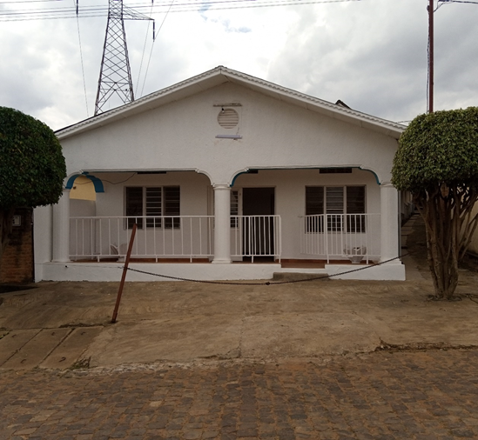
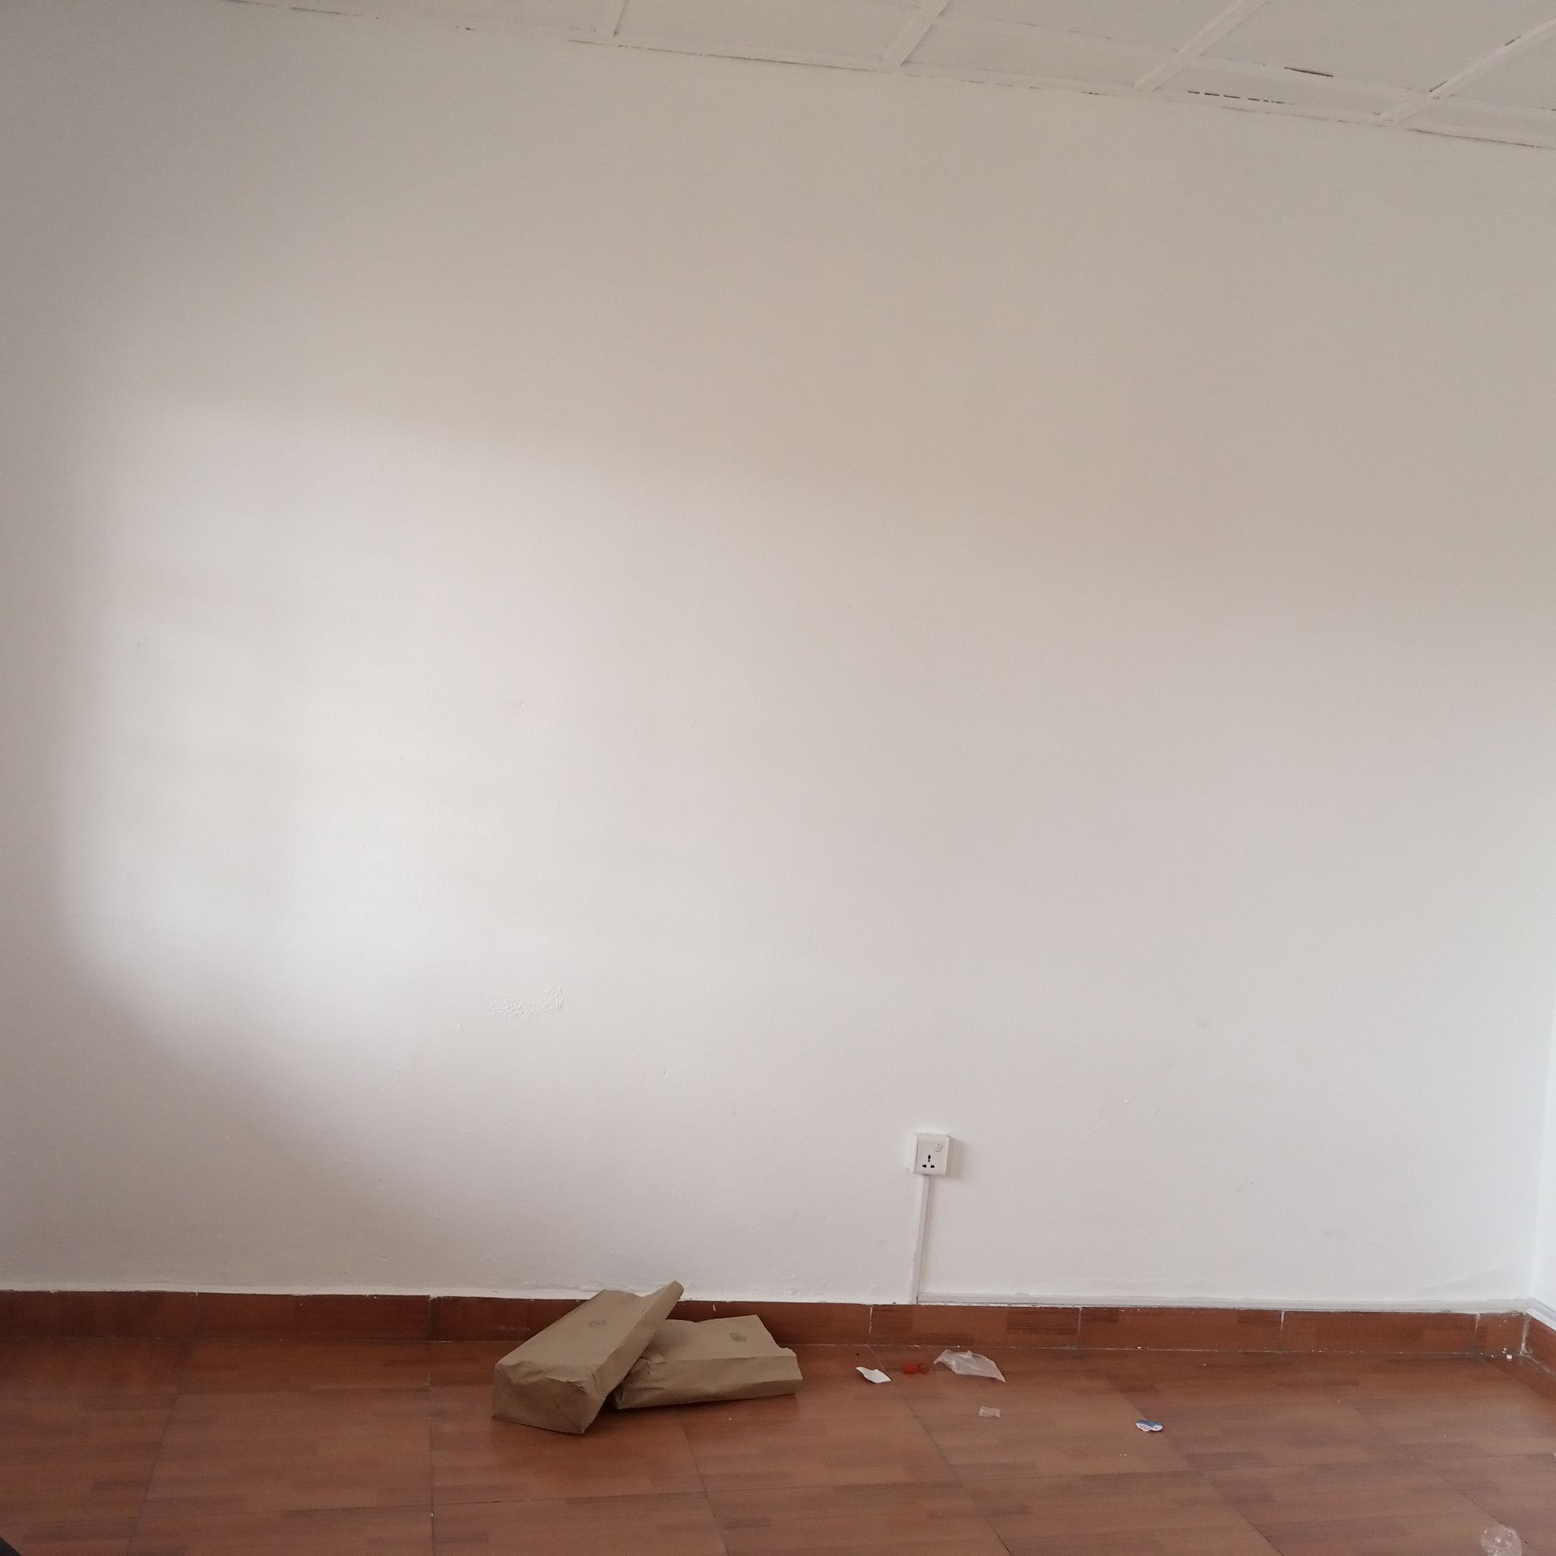
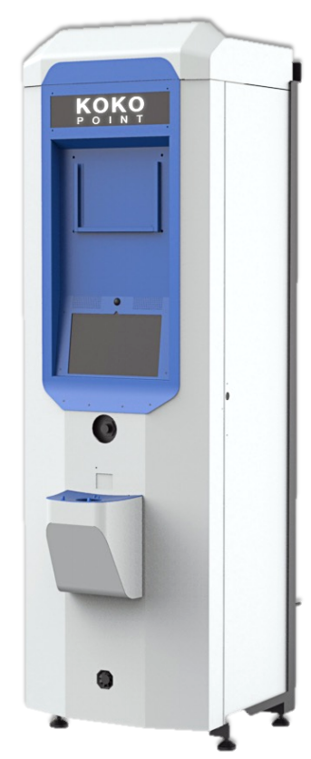
Inspection
Carried out shop inspection on 31st May 2021
The shop passed the inspection.
It’s located within middle and lower income residents
Fig 1. Pic showing Front of shop where KP was Installed
Fig 2. Pic showing where KP would be Installed

Slide 3
Ethanol Depot site Visit
Supplier
OBSERVATIONS
The Ethanol Supplier was Kepharma LTD.
The depot is fine for the start however it may not be able to serve more than 10 KOKOpoints.

Slide 4
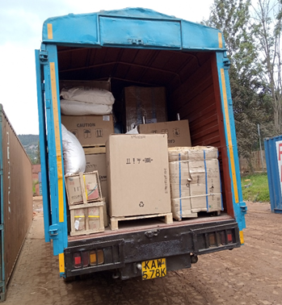
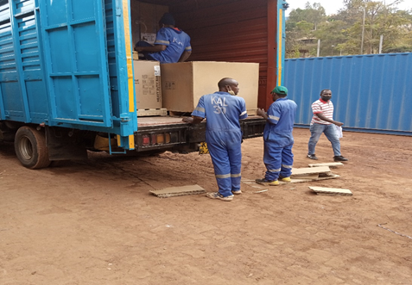
Cargo Arrival & Tests
Materials from KOKOPlex Kenya arrived in Magerwa warehouse in Kigali on 5th June.
It took 6 days for the cargo to be cleared from the warehouse.
In the evening of 12th June, we offloaded the cargo which had arrived at the inspected shop (Kigali Pilot Shop) from the warehouse.
After counter checking on all the materials that had arrived and confirmed that they are in the right condition.
Performed functionality test on the Mini STS and concluded that it was properly functioning.
Fig 3. Pic showing cargo being offloading

Slide 5
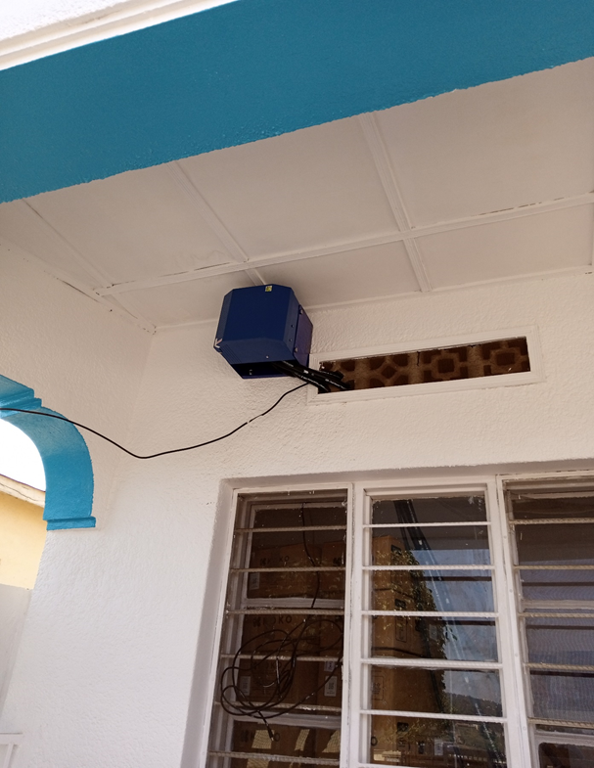
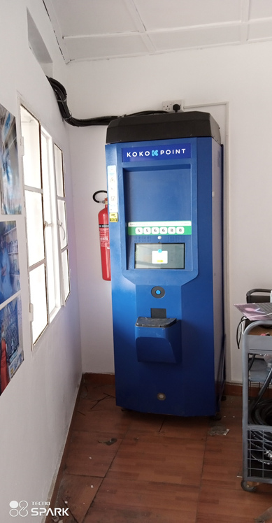
Civil works & KP Installation
Civil works
Installation Pics
On 13th June 2021, we confirmed the tools which had been bought Locally.
We managed to do the wiring, L-frame mounting and with the support of the local casuals, we managed to mount the KOKOpoint to the L-Frame.
External mounting of MBE Refill box bracket was done on 14th June 2021.
It was then followed by Refill box mounting and hose routing from the Refill box to the KOKOpoint.
Fig 4. Pic showing Refill Box
Fig 5. Pic showing KP Installed

Slide 6
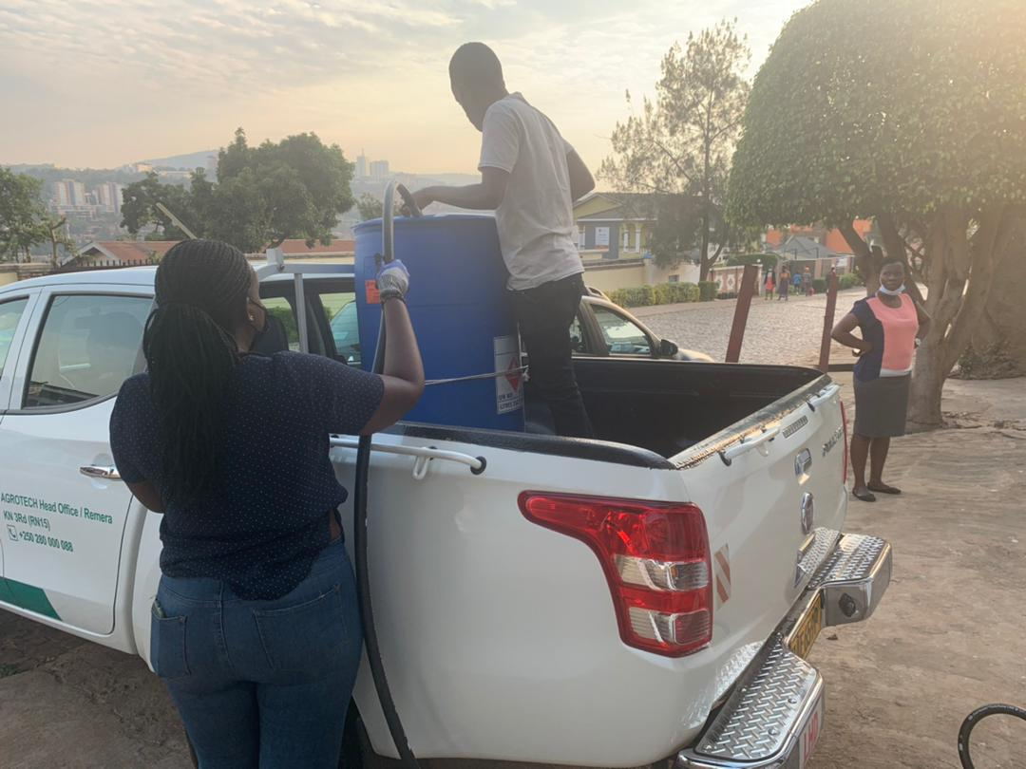
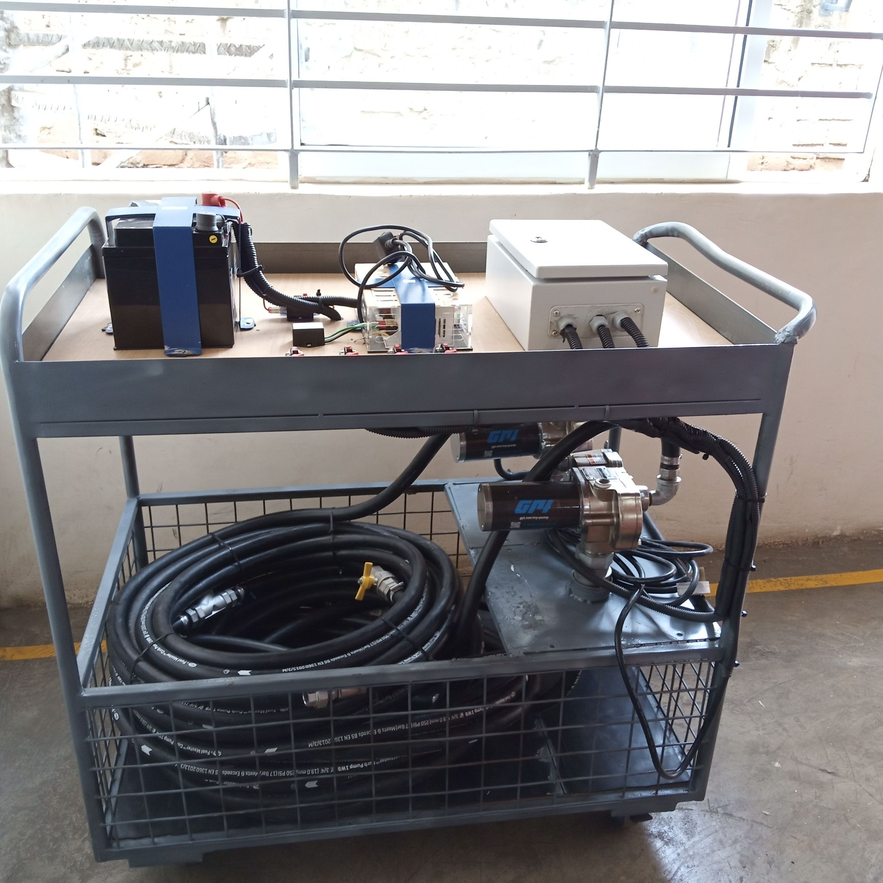
Modem Configuration and First refilling
On 14th June in the evening, With all hopes that Airtel Rwanda sim card could work since airtel Kenya sim card was working, we tried everything possible to ensure it responds positively to no success.
On 15th June we uploaded the latest firmware and tried again to configure the modem using the Airtel Rwanda, but there was no response.
In the morning of 16th June, we managed to configure the modem using the MTN Rwanda sim card, made it the primary sim card and disabled outsim switch.
The software engineer upgraded the KP to Prod-rw Server.
Late in the evening on 16th June we refilled the KP with 250L using the Mini STS.
Fueling Video Link
Fig 6. Pic showing Ethanol delivered by Kepharma Limited
Fig 7. Pic showing Mini STS

Slide 7
Performance Monitoring
Calibration & Commissioning
Demonstrations
17th June 2021, we managed to do calibration using the canisters which we registered as Rwanda calibration canisters.
We performed a number of canister refills. The main aim of this was to ensure the performance of the KP was fine.
We were able to monitor the flow rate, TL, leakage and the performance of all KP parts like Dispense valve, flow meter, Pump, Tank Sensor, Smart valve dock, etc.
Submitted the commissioning form after ensuring the KP was ready for the customers
On 18th June 2021, I demonstrated to 3 staff members (Noella, Honorine and Doreen) on how to buy the cooker, fuel and how to use the Koko Cooker.
They later on shared the same knowledge to other staff members from Dalberg.

Slide 8
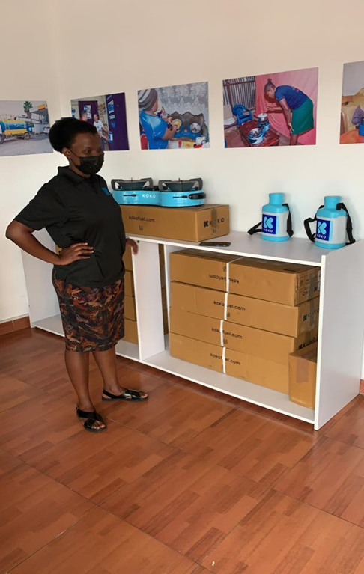
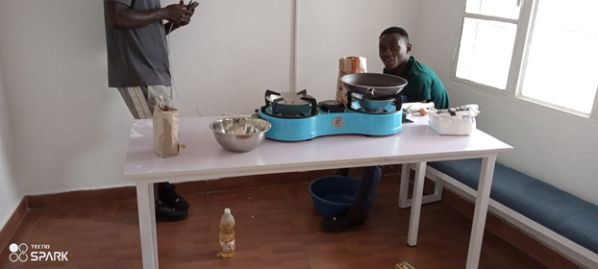
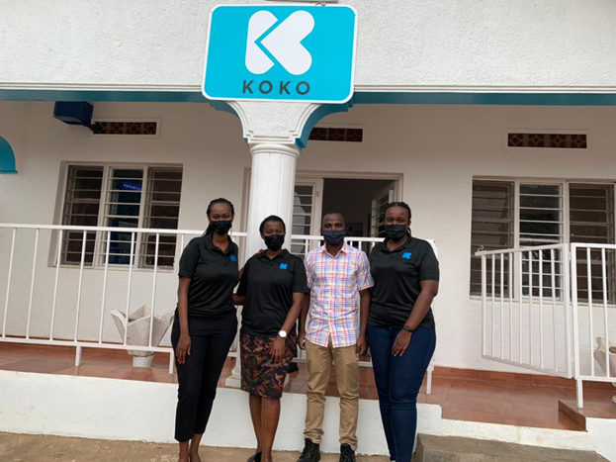
Other Pics
Fig 8. Honorine standing close to Cookers display
Fig 9. First Time using KOKO cooker cooking Chapati
Fig 10. From Left Doreen, Honorine, Omusina and Noella

Slide 9
Thank you -Murakoze
I’d like to Thank Koko Networks as a company, for the milestone and network expansion to an exciting region of the continent
I appreciate the following colleagues for the support they offered when we needed them most to ensure the project become successful.
Ed, Yasin, Noella, Brian Onyando, Duke, Samuel & Doreen.

Slide 10

Thank you

Slide 11
f.omusina@kokonetworks.com

